Slide 1
Why we test?

Slide 2
To not be afraid of code changes

Slide 3
It facilitates change (refactoring)

Slide 4
Learning unit testing doesn’t stop at mastering the technical bits of it, such as your favorite test framework, mocking library, and so on. There’s much more to unit testing than the act of writing tests. You always have to strive to achieve the best return on the time you invest in unit testing, minimizing the effort you put into tests and maximizing the benefits they provide. Achieving both things isn’t an easy task.
It’s fascinating to watch projects that have achieved this balance: they grow effortlessly, don’t require much maintenance, and can quickly adapt to their customers' ever-changing needs. It’s equally frustrating to see projects that failed to do so. Despite all the effort and an impressive number of unit tests, such projects drag on slowly, with lots of bugs and upkeep costs.
That’s the difference between various unit testing techniques. Some yield great outcomes and help maintain software quality. Others don’t: they result in tests that don’t contribute much, break often, and require a lot of maintenance in general.

Slide 5
Current state of unit testing
For the past two decades, there’s been a push toward adopting unit testing. The push has been so successful that unit testing is now considered mandatory in most companies. Most programmers practice unit testing and understand its importance. There’s no longer any dispute as to whether you should do it. Unless you’re working on a throw-away project, the answer is: you do.

Slide 6
But, as with all new technologies, unit testing continues to evolve. The discussion has shifted from "Should we write unit tests?" to "What does it mean to write good unit tests?" This is where the main confusion still lies.
You can see the results of this confusion in software projects. Many projects have automated tests; they may even have a lot of them. But the existence of those tests often doesn’t provide the results the developers hope for. It can still take programmers a lot of effort to make progress in such projects. New features take forever to implement, new bugs constantly appear in the already implemented and accepted functionality, and the unit tests that are supposed to help don’t seem to mitigate this situation at all. They can even make it worse.

Slide 7
The goal of unit testing
Before taking a deep dive into the topic of unit testing, let’s step back and consider the goal that unit testing helps you to achieve. It’s often said that unit testing practices lead to a better design. And it’s true: the necessity to write unit tests for a code base normally leads to a better design. But that’s not the main goal of unit testing; it’s merely a pleasant side effect.
The ability to unit test a piece of code is a nice litmus test, but it only works in one direction. It’s a good negative indicator — it points out poor-quality code with relatively high accuracy. If you find that code is hard to unit test, it’s a strong sign that the code needs improvement. The poor quality usually manifests itself in tight coupling, which means different pieces of production code are not decoupled from each other enough, and it’s hard to test them separately.
Unfortunately, the ability to unit test a piece of code is a bad positive indicator. The fact that you can easily unit test your code base doesn’t necessarily mean it’s of good quality. The project can be a disaster even when it exhibits a high degree of decoupling.

Slide 8
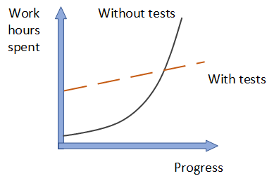
What is the goal of unit testing, then? The goal is to enable sustainable growth of the software project. The term sustainable is key. It’s quite easy to grow a project, especially when you start from scratch. It’s much harder to sustain this growth over time.
Figure 1.1 shows the growth dynamic of a typical project without tests. You start off quickly because there’s nothing dragging you down. No bad architectural decisions have been made yet, and there isn’t any existing code to worry about. As time goes by, however, you have to put in more and more hours to make the same amount of progress you showed at the beginning. Eventually, the development speed slows down significantly, sometimes even to the point when you can’t make any progress whatsoever.

Slide 9
This phenomenon of quickly decreasing development speed is also known as software entropy. Entropy (the amount of disorder in a system) is a mathematical and scientific concept that can also apply to software systems. (If you’re interested in the math and science of entropy, look up the second law of thermodynamics.)
In software, entropy manifests in the form of code that tends to deteriorate. Each time you change something in a code base, the amount of disorder in it, or entropy, increases. If left without proper care, such as constant cleaning and refactoring, the system becomes increasingly complex and disorganized. Fixing one bug introduces more bugs, and modifying one part of the software breaks several others — it’s like a domino effect. Eventually, the code base becomes unreliable. And worst of all, it’s hard to bring it back to stability.

Slide 10
Tests help overturn this tendency. They act as a safety net — a tool that provides insurance against a vast majority of regressions. Tests help make sure the existing functionality works, even after you introduce new features or refactor the code to better fit new requirements.
The downside here is that tests require initial, sometimes significant, effort. But they pay for themselves in the long run by helping the project to grow in the later stages. Software development without the help of tests that constantly verify the code base simply doesn’t scale.
Sustainability and scalability are the keys. They allow you to maintain development speed in the long run.

Slide 11
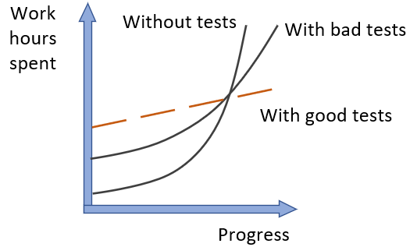
What makes a good or bad test?
As shown in figure 1.2, bad tests do help to slow down code deterioration at the beginning: the decline in development speed is less prominent compared to the situation with no tests at all. But nothing really changes in the grand scheme of things. It might take longer for such a project to enter the stagnation phase, but stagnation is still inevitable.
It’s easy to create tests whose net value is close to zero or even is negative due to high maintenance costs. To enable sustainable project growth, you have to exclusively focus on high-quality tests — those are the only type of tests that are worth keeping in the test suite.

Slide 12
Remember, not all tests are created equal. Some of them are valuable and contribute a lot to overall software quality. Others don’t. They raise false alarms, don’t help you catch regression errors, and are slow and difficult to maintain. It’s easy to fall into the trap of writing unit tests for the sake of unit testing without a clear picture of whether it helps the project.
You can’t achieve the goal of unit testing by just throwing more tests at the project. You need to consider both the test’s value and its upkeep cost. The cost component is determined by the amount of time spent on various activities:
Refactoring the test when you refactor the underlying code
Running the test on each code change
Dealing with false alarms raised by the test
Spending time reading the test when you’re trying to understand how the underlying code behaves
It’s easy to create tests whose net value is close to zero or even is negative due to high maintenance costs. To enable sustainable project growth, you have to exclusively focus on high-quality tests — those are the only type of tests that are worth keeping in the test suite.

Slide 13
PRODUCTION CODE VS. TEST CODE
People often think production code and test code are different. Tests are assumed to be an addition to production code that has no cost of ownership. By extension, people often believe that the more tests, the better.
This isn’t the case. Code is a liability, not an asset. The more code you introduce, the more you extend the surface area for potential bugs in your software, and the higher the project’s upkeep cost. It’s always better to solve problems with as little code as possible.
Tests are code, too. You should view them as the part of your code base that aims at solving a particular problem: ensuring the application’s correctness. Unit tests, just like any other code, are also vulnerable to bugs and require maintenance.

Slide 14
Using coverage metrics to measure test suite quality
There are different types of coverage metrics, and they’re often used to assess the quality of a test suite. The common belief is that the higher the coverage number, the better.
Unfortunately, it’s not that simple, and coverage metrics, while providing valuable feedback, can’t be used to effectively measure the quality of a test suite. It’s the same situation as with the ability to unit test the code: coverage metrics are a good negative indicator but a bad positive one.
If a metric shows that there’s too little coverage in your code base — say, only 10% — that’s a good indication that you are not testing enough. But the reverse isn’t true: even 100% coverage isn’t a guarantee that you have a good-quality test suite. A test suite that provides high coverage can still be of poor quality.

Slide 15
Understanding the code-coverage metric
Code coverage (test coverage) = Lines of code executed / Total number of lines
Notes:
THE CODE COVERAGE (TEST COVERAGE) METRIC IS CALCULATED AS THE RATIO BETWEEN THE NUMBER OF CODE LINES EXECUTED BY THE TEST SUITE AND THE TOTAL NUMBER OF LINES IN THE PRODUCTION CODE BASE.

Slide 16
Tested 3/4 lines = > Line coverage = 75%
Tested 2/2 lines = > Line coverage = 100%
Notes:
It’s easy to calculate the code coverage here. The total number of lines in the method is five (curly braces count, too). The number of lines executed by the test is four — the test goes through all the code lines except for the return true statement. This gives us 4/5 = 0.8 = 80% code coverage.
Does the code-coverage number change? Yes, it does. Because the test now exercises all three lines of code (the return statement plus two curly braces), the code coverage increases to 100%.
But did I improve the test suite with this refactoring? Of course not. I just shuffled the code inside the method. The test still verifies the same number of possible outcomes.
This simple example shows how easy it is to game the coverage numbers. The more compact your code is, the better the test coverage metric becomes, because it only accounts for the raw line numbers. At the same time, squashing more code into less space doesn’t (and shouldn’t) change the value of the test suite or the maintainability of the underlying code base.

Slide 17
Understanding the branch coverage metric
Branch coverage = Branches traversed / Total number of branches
Notes:
THE BRANCH METRIC IS CALCULATED AS THE RATIO OF THE NUMBER OF CODE BRANCHES EXERCISED BY THE TEST SUITE AND THE TOTAL NUMBER OF BRANCHES IN THE PRODUCTION CODE BASE.

Slide 18
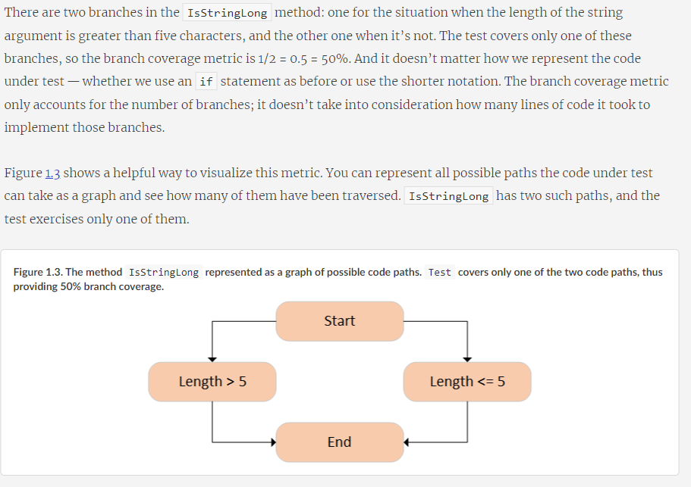

Slide 19
Problems with coverage metrics
Although the branch coverage metric yields better results than code coverage, you still can’t rely on either of them to determine the quality of your test suite, for two reasons:
You can’t guarantee that the test verifies all the possible outcomes of the system under test.
No coverage metric can take into account code paths in external libraries.
Let’s look more closely at each of these reasons.

Slide 20
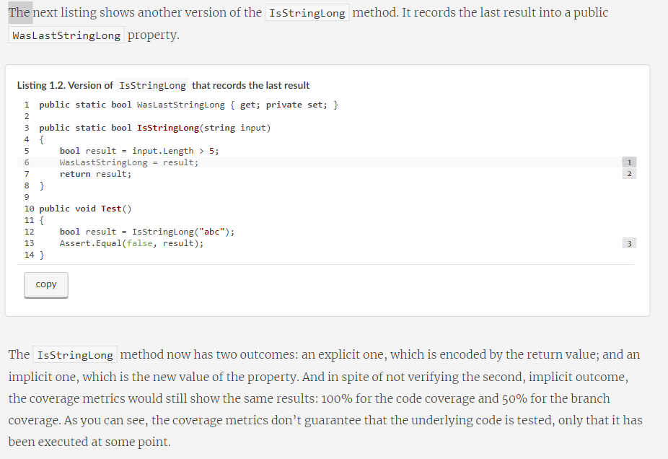

Slide 21
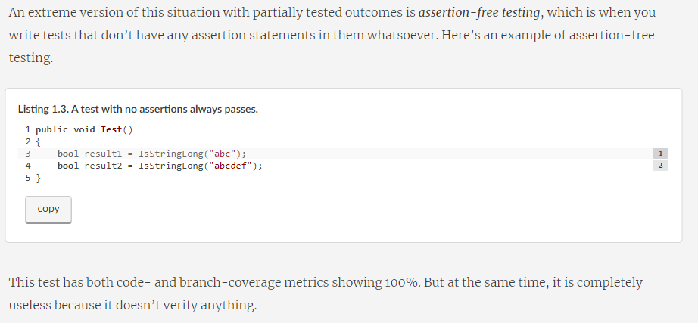

Slide 22
Aiming at a particular coverage number
At this point, I hope you can see that relying on coverage metrics to determine the quality of your test suite is not enough. It can also lead to dangerous territory if you start making a specific coverage number a target, be it 100%, 90%, or even a moderate 70%. The best way to view a coverage metric is as an indicator, not a goal in and of itself.
Think of a patient in a hospital. Their high temperature might indicate a fever and is a helpful observation. But the hospital shouldn’t make the proper temperature of this patient a goal to target by any means necessary. Otherwise, the hospital might end up with the quick and "efficient" solution of installing an air conditioner next to the patient and regulating their temperature by adjusting the amount of cold air flowing onto their skin. Of course, this approach doesn’t make any sense.
Likewise, targeting a specific coverage number creates a perverse incentive that goes against the goal of unit testing. Instead of focusing on testing the things that matter, people start to seek ways to attain this artificial target. Proper unit testing is difficult enough already. Imposing a mandatory coverage number only distracts developers from being mindful about what they test, and makes proper unit testing even harder to achieve.

Slide 23
I’ve spent most of this chapter discussing improper ways to measure the quality of a test suite: using coverage metrics. What about a proper way? How should you measure your test suite’s quality? The only reliable way is to evaluate each test in the suite individually, one by one. Of course, you don’t have to evaluate all of them at once; that could be quite a large undertaking and require significant upfront effort. You can perform this evaluation gradually. The point is that there’s no automated way to see how good your test suite is. You have to apply your personal judgment.

Slide 24
A successful test suite has the following properties
It’s integrated into the development cycle.
It targets only the most important parts of your code base.
It provides maximum value with minimum maintenance costs.
Notes:
It’s integrated into the development cycle
The only point in having automated tests is if you constantly use them. All tests should be integrated into the development cycle. Ideally, you should execute them on every code change, even the smallest one.

Slide 25

How we test?

Slide 26
https://stackoverflow.com/questions/29669393/override-default-spring-boot-application-properties-settings-in-junit-test
[Update: Overriding certain properties for testing]
Add src/main/resources/application-test.properties.
Annotate test class with @ActiveProfiles("test").
This loads application.properties and then application-test.properties properties into application context for the test case, as per rules defined here.
Conclusion: ActiveProfiles will append the properties file with the name of the property ex:@ActiveProfiles(”foobar") -> application- foobar.properties

